Slide 1
Bayesian Models
Lecture 6
Or "Bear-sian models"

Slide 2
Wednesday, August 28th
National Thoughtful Day
National Cherry Turnover Day
National Power Rangers Day
National Bow Tie Day
National Cherry Turnover Day

Slide 3
Announcements
Assignment 1 due today by midnight -- if you are having trouble, email me. If you have just added the class and need an extension, email me
For today's live-coding portion, you will want
  The faults.csv, located in canvas under "datasets"
  Scikit-learn installed
  Matplotlib installed
  Seaborn installed

Slide 4

Announcements

Slide 5

Announcements- Manufacturing Scholarship
https://www.fmamfg.org/foundation/scholarships
Due September 30th
Up to $2k/semester
Must be pursuing or planning to pursue a degree or certificate related to automation/manufacturing (I believe the Robotics certificate would qualify)

Slide 6

Announcements- NASA Internships
https://www.nasa.gov/learning-resources/internship-programs/
Spring 2025, Summer 2025
Early decision deadline – Oct 25th
Regular decision deadline - February 28th
NASA Idaho Space Grant Consortium usually has a webinar for this

Slide 7
Announcements – Grad School
I will be teaching in person, on Friday, 8/30
If you have any interest in graduate school or want to learn more about it, I'd be happy to talk to you before or after class on Friday.

Slide 8
Lecture Resources
I'm using Khan Academy Notes to Prepare some of this section: https://www.khanacademy.org/math/statistics-probability/probability-library/basic-theoretical-probability/a/probability-the-basics
And some of investopedia's notes: https://www.investopedia.com/terms/j/jointprobability.asp
And 3 Blue 1 Brown has a fantastic video explaining the theory: https://youtu.be/HZGCoVF3YvM?si=7HPwxlipvZ1o9A9U
And really good notes: https://www.3blue1brown.com/lessons/bayes-theorem
Stat Quest has a good video explaining the classifier model: https://youtu.be/O2L2Uv9pdDA?si=3zRiaZ6mDi94FUNx

Slide 9
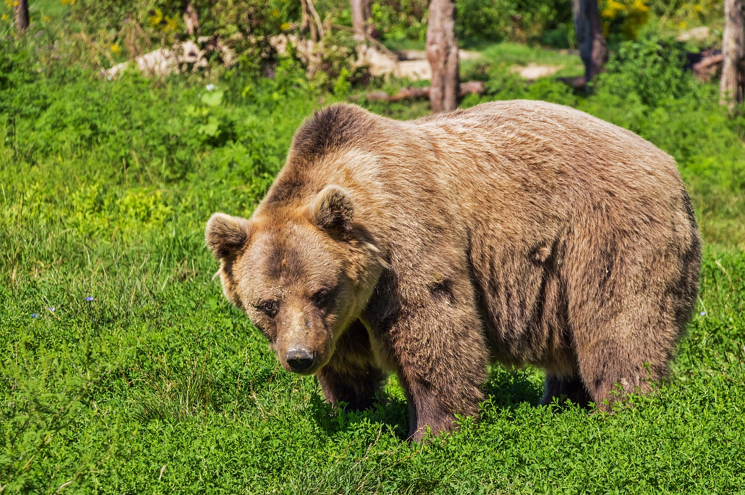
Basic Probability and Getting Eaten by Bears

Slide 10
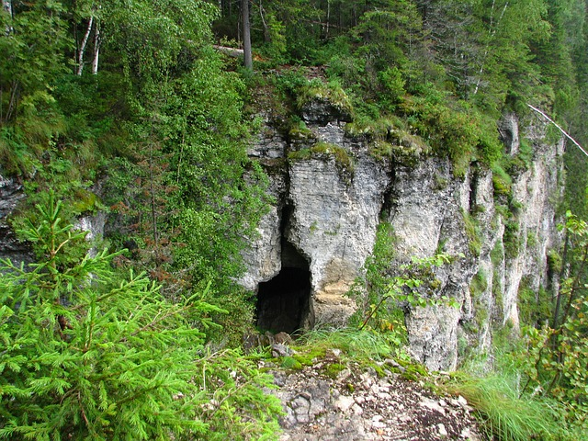
Situation
You are on a camping trip in our great Pacific Northwest
Against the advice of your friends, you decide to explore a cave
You have six caves to choose from
There is a grizzly bear in this region and you know that it's made a home in one of the caves
What's the probability you get eaten by a bear?

Slide 11
Probability
Khan academy notes – describes the probability of an event as the number of ways the thing can happen divided by the total number of outcomes
The number of ways you can get eaten by a bear when exploring the cave is 1, since there is only one bear
The total number of outcomes is 6, since there are six caves to explore
So the probability is 1/6 or 0.167 or 16.7%

Slide 12

Probability of Getting Eaten by the Bear
Pretty low probability
Yet admittedly the best choice is probably not to explore the caves at all

Slide 13
Joint and Conditional Probability
And still not getting eaten by a bear

Slide 14

Situation
Let's say you've moved on to a different part of the forest, and for some reason you still want to explore caves
Your friendly local forest ranger, who is trying to talk you out of this idea, gives you some information:
  There are 20 total caves in this region
  And 5 bears (they are territorial bears, so only every be one bear per cave. But all bears will be in a cave).
  Unfortunately, he also lets it slip that 8 of the caves have huckleberry bushes
  I am You are a huckleberry fanatic
  But so are bears, and the forest ranger tells you that 2 of the 5 bears in are in huckleberry cave

Slide 15
What are the chances of finding both a bear and a huckleberry bush in the same cave?
Joint probability
2 out of the 20 caves have both bears and huckleberries
So joint probability is 0.10 or 10%
P(Bear U Huckleberries) =10%

Slide 16

But what you really want to know is...
Will my huckleberry addiction cost me my life?
Let's say you can see if the cave has a huckleberry bush from the entrance, and need to decide if you should go in
What you're actually interested in at this point is the probability of a cave having a bear in it if you know the cave has huckleberries
This is looking at a subset of options and outcomes

Slide 17




Slide 18
Time to Decide
We see huckleberries in the cave
What are chances we get eaten by the bear?
Total number of outcomes, given the evidence (huckleberries)?

Slide 20
Time to Decide
We see huckleberries in the cave
What are chances we get eaten by the bear?
Total number of outcomes, given the evidence (huckleberries)?
  8 possible outcomes
Of those outcomes, how many end with us eaten by a bear?

Slide 22
Time to Decide
We see huckleberries in the cave
What are chances we get eaten by the bear?
Total number of outcomes, given the evidence (huckleberries)?
  8 possible outcomes
Of those outcomes, how many end with us eaten by a bear?
  2 of these outcomes
So what is the probability of getting eaten by a bear given that the cave has huckleberries?

Slide 23
Time to Decide
We see huckleberries in the cave
What are chances we get eaten by a bear?
Total number of outcomes, given the evidence (huckleberries)?
  8 possible outcomes
Of those outcomes, how many end with us eaten by a bear?
  2 of these outcomes
So what is the probability of getting eaten by a bear given that the cave has huckleberries?
  2/8 or 25%
  You are running a real risk here

Slide 24
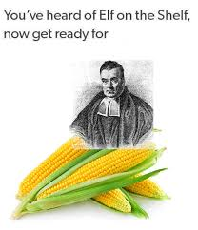
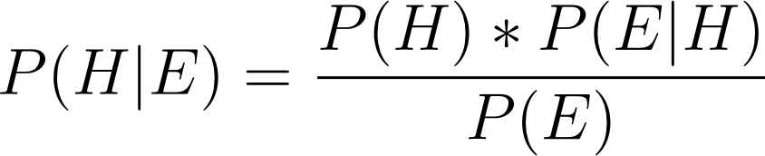
Bayes Theorem
Relying heavily on 3Blue 1Brown notes – they are very good
P(H|E) = [ P(H) * P(E|H) ] / P(E)
P(H|E) = Probability of the hypotheses (H) being true given the evidence (E)
P(H) Probability of the hypotheses
P(E|H) Probability of the Evidence given the Hypothesis
P(E) Probability of the Evidence
https://www.facebook.com/p/Bayesian-Memes-for-Frequentist-Teens-100067098520870/

Slide 25
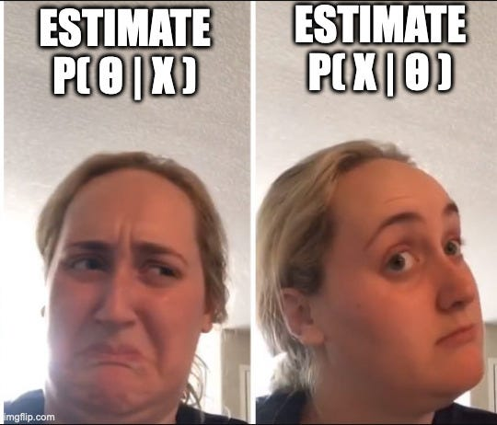
https://mindfulmodeler.substack.com/p/bayesian-inference-from-first-principles

Slide 26
 | Bear (H) | No Bear | Total
No huckleberries | 3 | 9 | 12
Huckleberries (E) | 2 | 6 | 8
Total | 5 | 15 | 20

Slide 28
Use Bayes Theorem to figure out if we get eaten by a Bear
P(H) - this is called your "prior"
Our hypothesis is that we will get eaten by a bear
We aren't factoring in evidence yet
It is the number of outcomes that match your hypothesis divided by the total number of outcomes
In this case, the total number of outcomes is 20 (20 caves to explore)
The outcomes that match our hypothesis (death by bear) are 5
So P(H) = 5/20 = 25%

Slide 29
Use Bayes Theorem to figure out if we get eaten by a Bear
Next, let's get P(E|H) - called the likelihood
Probability of seeing the evidence that we see given our hypothesis
Again – our hypothesis is that we will get eaten by a bear
Our evidence is that we see a huckleberry bush by the cave
So, our likelihood is the percent of bear caves with huckleberry bushes
So 2/5 = 0.4

Slide 30
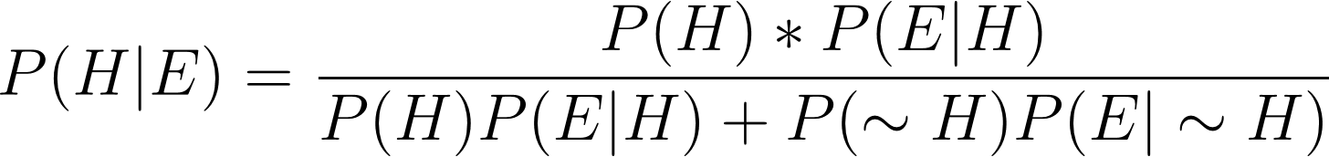
Use Bayes Theorem to figure out if we get eaten by a Bear
Now we need P(E) - the probability of our evidence
Which comes out to:
  P(H)P(E|H) + P(~H)P(E|~H)
  Where ~H means not the hypothesis
We know P(H) and P(E|H)
What is the probability of not the hypothesis? P(~H)
Number of caves that don't have bears/total number of caves
15/20 = 75%

Slide 31
Use Bayes Theorem to figure out if we get eaten by a Bear
Now we need P(E) - the probability of our evidence
We know in our example it's the number of huckleberry bushes / total number of caves
But practically:
Which comes out to:
  P(H)P(E|H) + P(~H)P(E|~H)
  Where ~H is not hypothesis
What is the probability of seeing the evidence if the hypothesis is not True? (P(E|~H)
We know 6 non-bear caves have huckleberries
So it's 6/15 = 40%

Slide 32
Use Bayes Theorem to figure out if we get eaten by a Bear
P(H)P(E|H) + P(~H)P(E|~H)
P(H) = 0.25
P(E|H) = 0.4
P(~H) = 0.75
P(E|~H) = 0.40
So the denominator = 0.25*0.4 + 0.75*0.40
P(E) = 0.4

Slide 33
Put it together
P(H) = 0.25
P(E|H) = 0.4
P(E) = 0.4
= (0.25*0.4)/0.4 = 0.25
25%

Slide 34
Bayes Theorem
Can be fairly intuitive
Again, don't get bogged by notation
When you see "|", the "given" sign, that restricts your view of the total outcomes
P(H) - unrestricted view – % of bear caves out of total
P(~H) - unrestricted view - % of not bear caves out of total
P(E|H) - restricted view - % of huckleberry caves out of bear caves
P(E|~H) - restricted view - % of huckleberry caves out not non-bear caves

Slide 35
How does this help us?
We can treat the hypothesis as an outcome
And we can even have multiple classes
Then we can form a classifier from our data
We will treat the features of our data as our evidence
We can evaluate each piece of evidence with regard to our outcome
And thus create a probability for each outcome
Which then lets us evaluate the most likely outcome!

Slide 36
Bear Example, one last time
Let's say we now have a Bear Attack dataset.
The outcome is whether or not a bear attacked based on someone's decision to explore the cave
The features are characteristics of the cave
  Whether or not the cave had huckleberries
  Whether ornot the cave had a lot of trees around it
  Whether or not the cave faced North
This forest has a lot of dumb hikers, so you have a decent amount of data

Slide 37
How would you create a Bayes Classifier?
Using Bayes Theorem
You would evaluate the probability of the bear attack outcome given the feature evidence
And evaluate the probability of not a bear attack given the feature evidence
And choose to predict whichever one is higher
This can be extended for multiple classes

Slide 38
How do we get probabilities from Features?
Estimating overall probabilities aren't too hard
  P(Bear Attack) = # of bear attacks in the dataset / # rows in dataset total (we can estimate)
  P(~Bear Attack) = # of non-bear attacks in dataset / # of rows total (we can estimate)
What about getting probabilities from features?
If your evidence is discrete (like in this example)
For P(H|E), P(~H|E), you would separate each outcome and calculate the ratio of evidence to that outcome
For example, to get probabilities we need for our huckleberry features we split the dataset into bear attack and non-bear attack outcomes, and calculate the ratio of huckleberry evidence for each

Slide 39
Naïve Bayes Classifier
So, it is actually pretty straightforward to get a naïve bayes classifier from bayes theorem and data
For a continuous random variable, we might get probabilities by modeling the distribution as normal or something similar and calculating z-scores
But in either case, getting probabilities from our features is pretty easy in software
And then bayes allows us to evaluate which class is more likely

Slide 40
Naïve Bayes
Multinomial naïve bayes: for use on discrete feature variables
Gaussian naïve bayes: Use on features that are continuous random variables

Slide 41
Other Considerations
Might log the probabilities to smooth out how small they can get for computational sake
And...

Slide 42
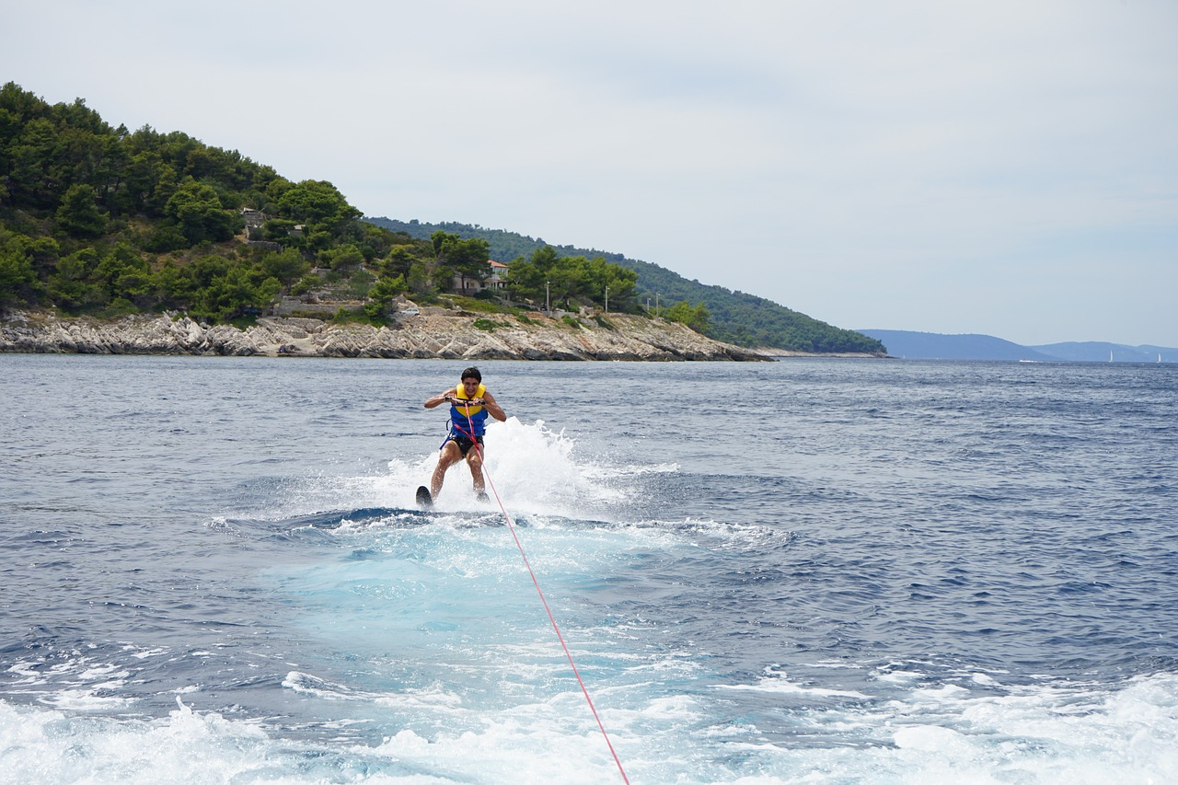
A bad Bayes Model could make you afraid to waterski
Bayes Theorem is thought to sort of underly your own reasoning and intuition
What if you've never had a certain outcome associated with a feature in your data?

Slide 43

A Not-So Hypothetical Example
Let's say someone has been to the lake 100s of times
Their mental dataset has 1 feature – activity at the lake
It's very skewed since they mostly swim open water
But other activities might include kayaking, tubing, or waterskiing
And this dataset has one of two outcomes:

Slide 44
A Not-So Hypothetical Example
Let's say someone has been to the lake 100s of times
Their mental dataset has 1 feature – activity at the lake
It's very skewed since they mostly swim open water
But other activities might include kayaking, tubing, or waterskiing
And this dataset has one of two outcomes:
  Leg caught in boat propeller
  Leg not caught in boat propeller

Slide 45
A Not-So Hypothetical Example
P(Leg caught in boat propeller | waterski)
P(Leg not caught in boat propeller | waterski)
=
=
P(Leg in propeller)*P( waterski | leg in propeller)
P(Leg not in propeller)*P( waterski | leg not in propeller)
P(Leg in propeller)*P(waterski | leg in propeller) + P(not leg in propeller)*P(waterski | leg not in propeller)
P(Leg not in propeller)*P(waterski | leg not in propeller) + P(leg in propeller)*P(waterski | leg in propeller)

Slide 46
Okay, so what happens if....
The only time this hypothetical person went waterskiing, they got their leg caught in the boat propeller?
Let's pretend this person has been to the lake 1000 times

Slide 47
A Not-So Hypothetical Example
P(Leg caught in boat propeller | waterski)
P(Leg not caught in boat propeller | waterski)
=
=
P(Leg in propeller)*P( waterski | leg in propeller)
P(Leg not in propeller)*P( waterski | leg not in propeller)
P(Leg in propeller)*P(waterski | leg in propeller) + P(not leg in propeller)*P(waterski | leg not in propeller)
P(Leg not in propeller)*P(waterski | leg not in propeller) + P(leg in propeller)*P(waterski | leg in propeller)

Slide 48
A Not-So Hypothetical Example
P(Leg caught in boat propeller | waterski)
P(Leg not caught in boat propeller | waterski)
=
=
0.001*1
0.999*0
0.001 + 0.999*0
0 + 0.001

Slide 49
A Not-So Hypothetical Example
P(Leg caught in boat propeller | waterski)
P(Leg not caught in boat propeller | waterski)
=
=
0.001*1
0.999*0
0.001 + 0.999*0
0 + 0.001
=
=
0
1

Slide 50
So, practically
You might want to add a small number of every "hypothesis" occurrence to each evidence feature to avoid that situation

Slide 51

Let's Code an Example
Buscema,M, Terzi,S, and Tastle,W. (2010). Steel Plates Faults. UCI Machine Learning Repository. https://doi.org/10.24432/C5J88N.
I'm using the kaggle csv: https://www.kaggle.com/code/tahazafar/steel-plate-faults-data-analysis/input
Steel Plate Dataset – Predict Which Defect is present
27 input variables that describe the defect shape
We want to classify the fault based on features
And we'll use bayes
But first, let's classify this type of model

Slide 52
Back to Basics!
Dataset
Type of Machine Learning
Data Split
Model Evaluation

Slide 53
Back to Basics!
Dataset
  Steel faults. Input features = measurements. Output outcome = type of fault
Type of Machine Learning
Data Split
Model Evaluation

Slide 54
Back to Basics!
Dataset
  Steel faults. Input features = measurements. Output outcome = type of fault
Type of Machine Learning
  Supervised
Data Split
Model Evaluation

Slide 55
Back to Basics!
Dataset
  Steel faults. Input features = measurements. Output outcome = type of fault
Type of Machine Learning
  Supervised
Data Split
  Recommend Training/Test in this case
Model Evaluation

Slide 56
Back to Basics!
Dataset
  Steel faults. Input features = measurements. Output outcome = type of fault
Type of Machine Learning
  Supervised
Data Split
  Recommend Training/Test in this case
Model Evaluation
  Accuracy

Slide 57
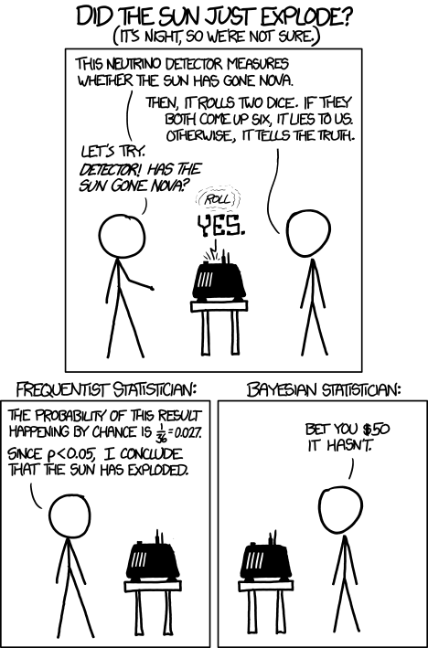
Bayesian vs. Frequentist Statistics
If you are interested:
https://www.redjournal.org/article/S0360-3016(21)03256-9/fulltext
https://www.explainxkcd.com/wiki/index.php/1132:_Frequentists_vs._Bayesians

Slide 58
Assignment 2 - Extending the Bayesian Model
You are going to extend the Bayesian model on the Steel defect dataset we coded in class to try and improve your accuracy. You will:
1. Pick only a subset of our input features, rather than all of them. Re-run the model (with a 10% test set). Note the accuracy. Did this increase or decrease? Why do you think this might be?
2. Pick a different subset of features (it doesn’t have to be 100% different, but at least some features should be), and re-run the model with a 10% test set. Note the accuracy. Did this increase or decrease? Why do you think this might be?
3. Pick one of the models from #1 or #2 and re-run it with a 5% test set and a 20% test set. Did your accuracy increase or decrease? Why?
4. Pick your best overall model so far. Get the predictions for all of your test data on the model. Figure out which type of defect it had the overall best predictions on (like Pastry, Dirtiness, etc) and report it. Why do you think this was the case (and I don’t expect you to be a steel expert, really vague answers on this one are okay)
Deliverables:
1. Your code file
2. A final report (about 2 pages), which describes each model you ran, reports the accuracy of each model, and answers the questions from the assignment description.
Make sure you cite your sources! The dataset is available on the “datasets” tab.

Slide 59
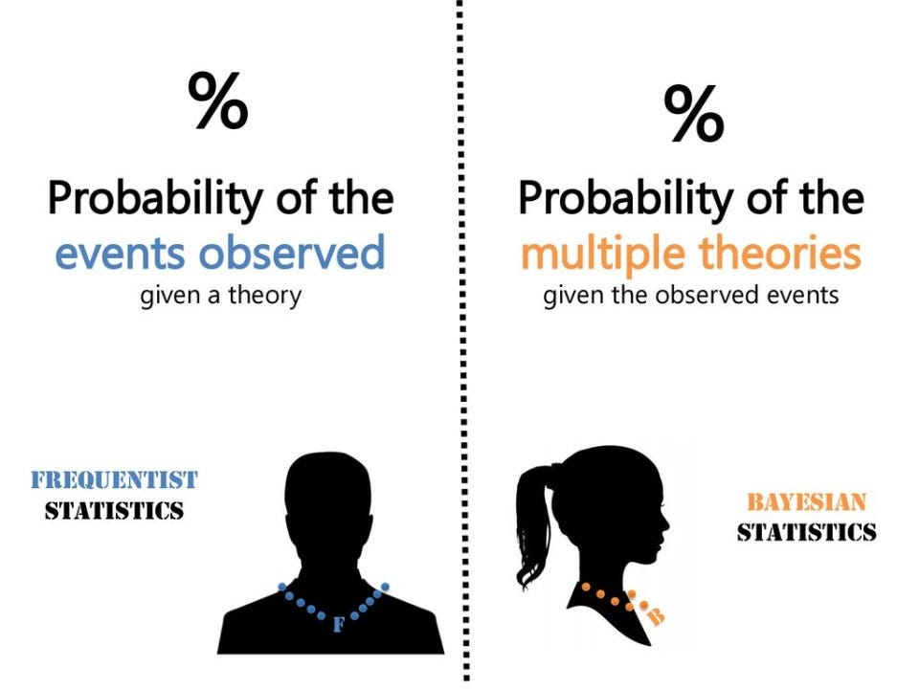
Questions?
https://medium.com/tiket-com/frequentist-vs-bayesian-statistics-in-data-science-a-b-testing-9a74212195e0

